Slide 1
Machine Learning
House Price Prediction

Slide 2
outline
EDA
Sale Price Analysis(descriptive Summary)
Numerical Feature
Catagorical Feature

Slide 3
Sale Price Analysis Descriptive Summary
,

Slide 4
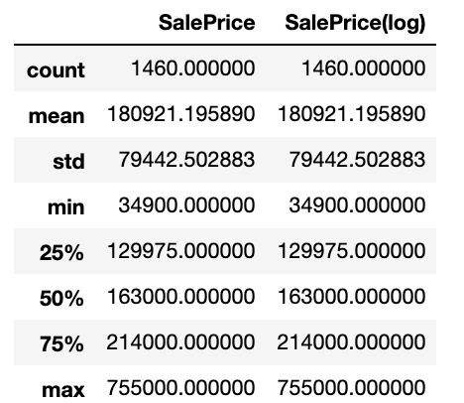
Sale Price Analysis Descriptive Summary
.

Slide 5
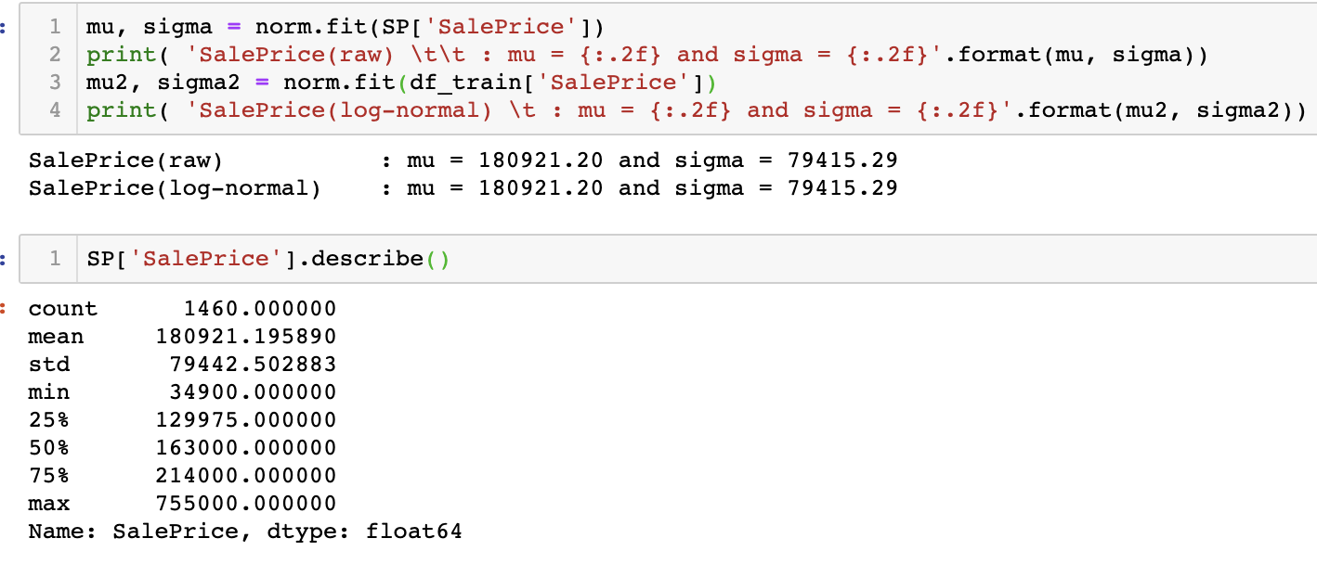
Histogram and Distribution
.

Slide 6
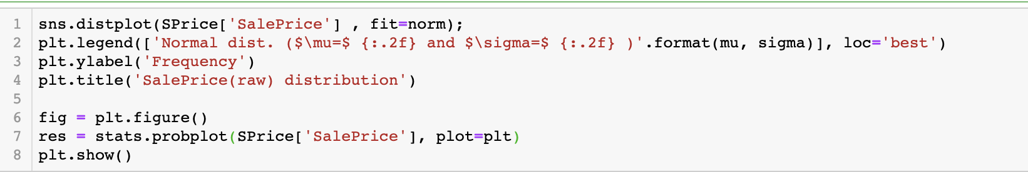
Histogram and Distribution continue..
.

Slide 7
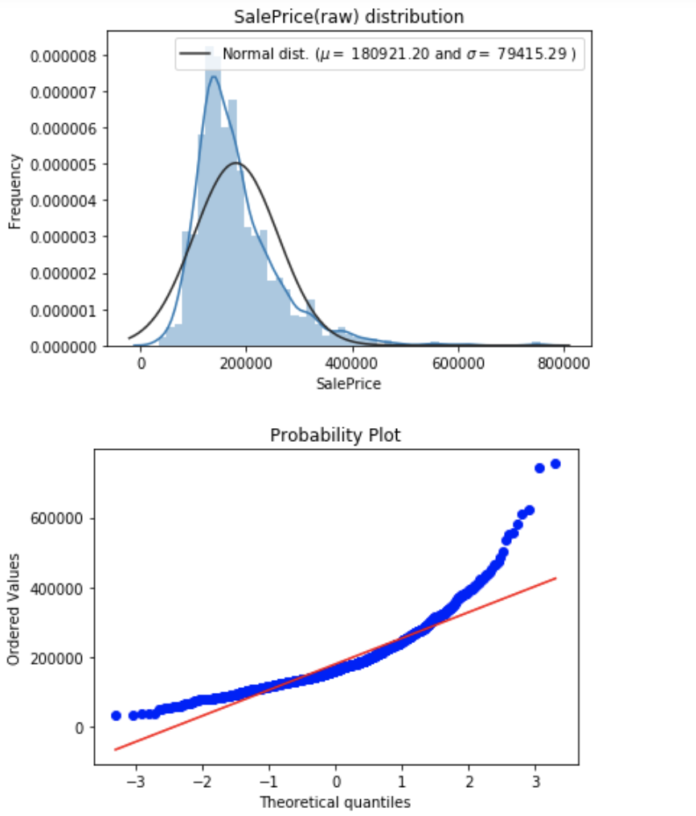
Histogram and Distribution
.

Slide 8
Histogram and Distribution
With this information we can see that the prices are skewed right and some outliers lies above ~500,000. We will eventually want to get rid of the them to get a normal distribution of the independent variable (SalePrice) for machine learning

Slide 9
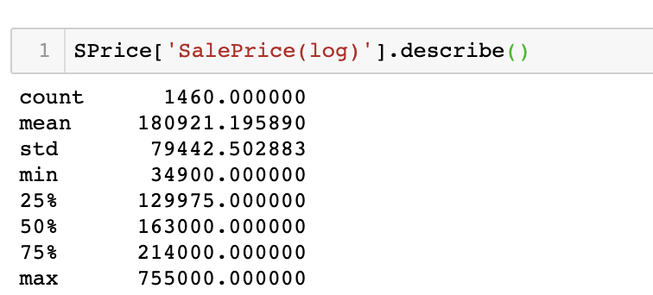
Log normal SalePrice Distribution
.

Slide 10
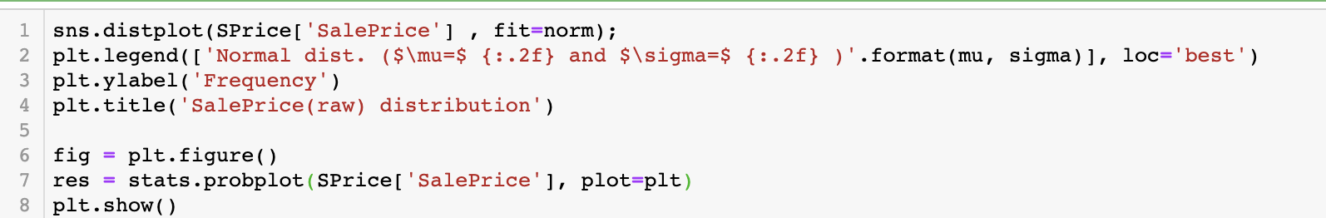
Log normal SalePrice Distribution
.

Slide 11
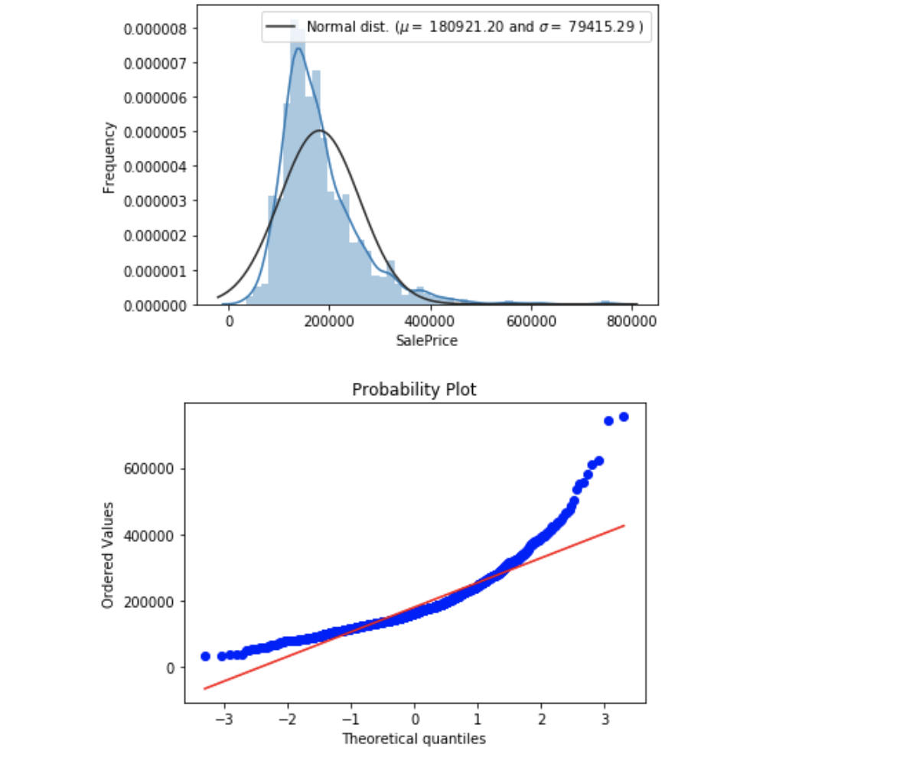
Log normal SalePrice Distribution
.

Slide 12
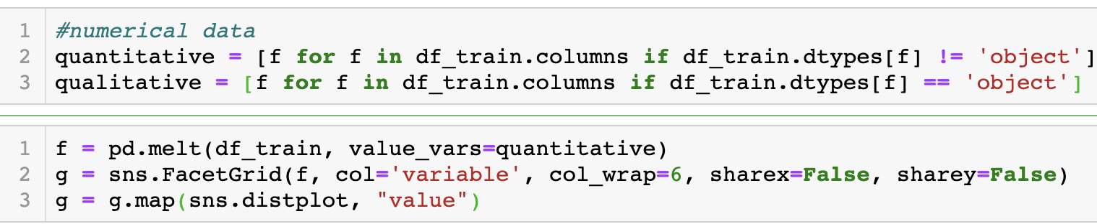
Numerical Data Exploration
.

Slide 13
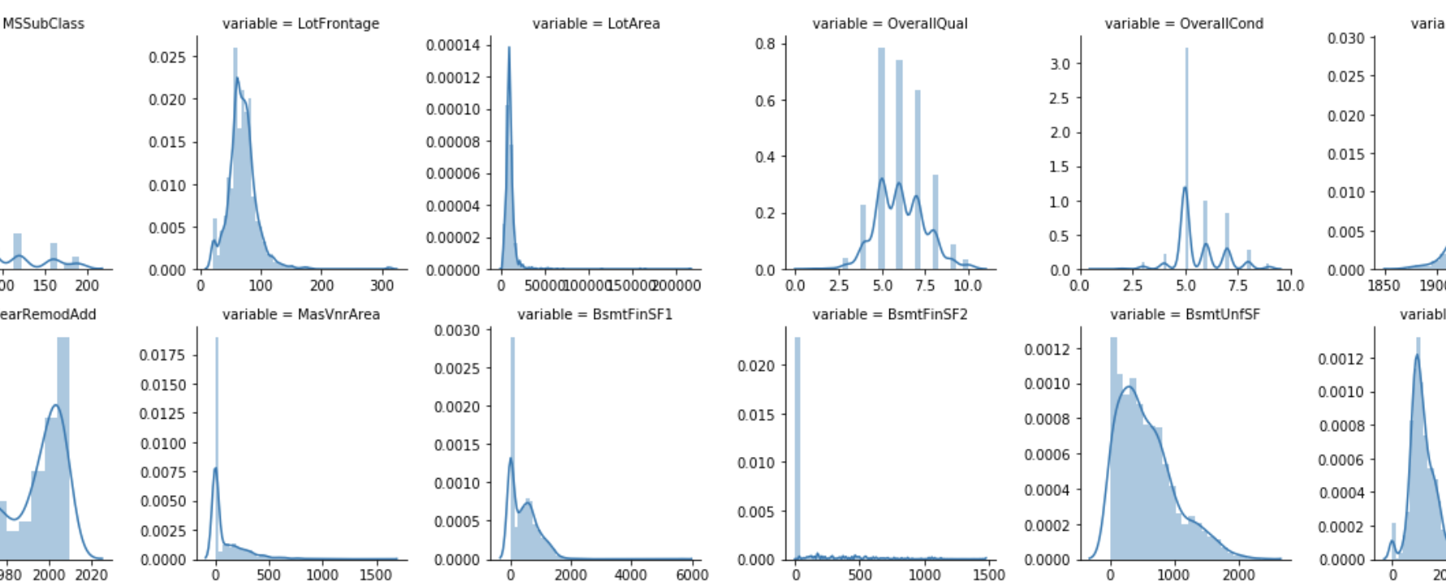
Numerical Data Explore
.

Slide 14
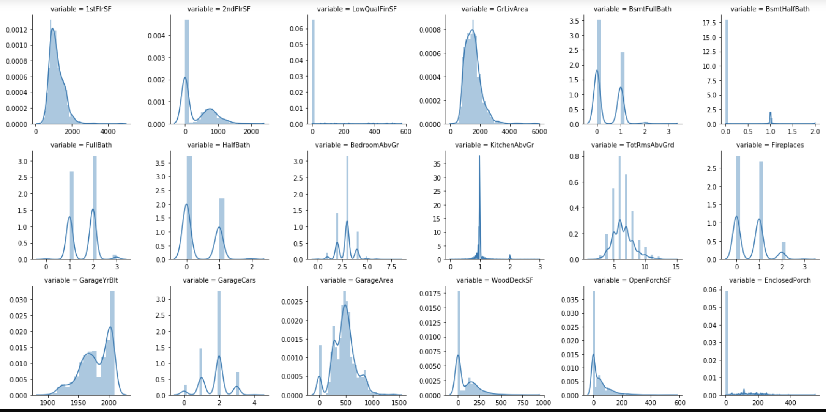
Numerical Data Explore Conti..
.

Slide 15
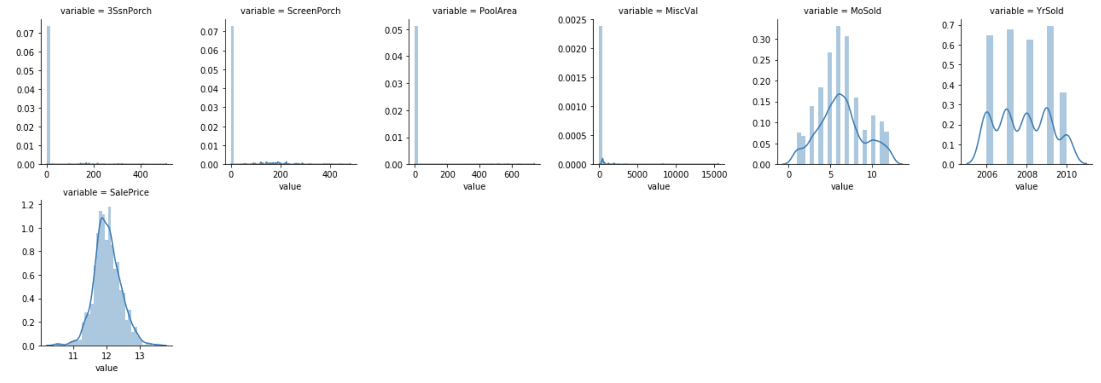
Numerical Data Explore Conti..
.

Slide 16
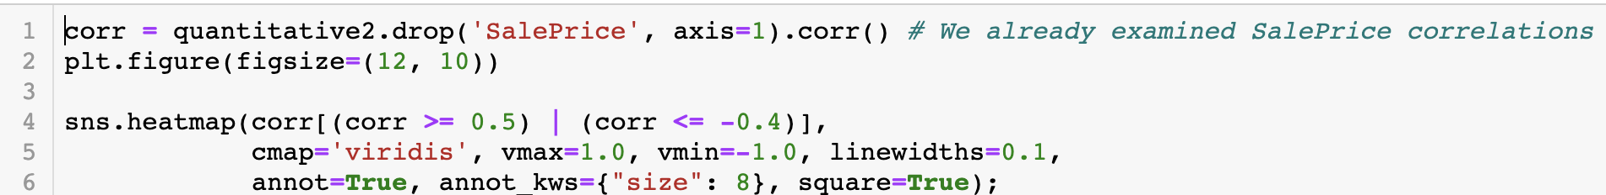
Numerical Data Correlations (Heatmap)
.

Slide 17
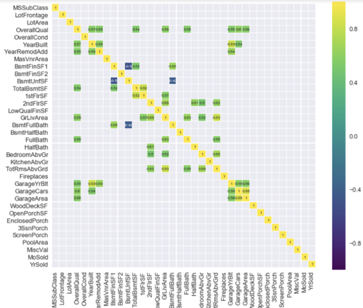
Numerical Data Correlations (Heatmap)
.

Slide 18
Numerical Data Correlations
Corr >= 0.5
1st Floor & Total Basement
Total Rooms Grd & Gr Liv Area
Garage Year Built & Year Built
Garage Area & Garage Cars
corr <= -0.4
Basement Full Bath
Basement Unif

Slide 19
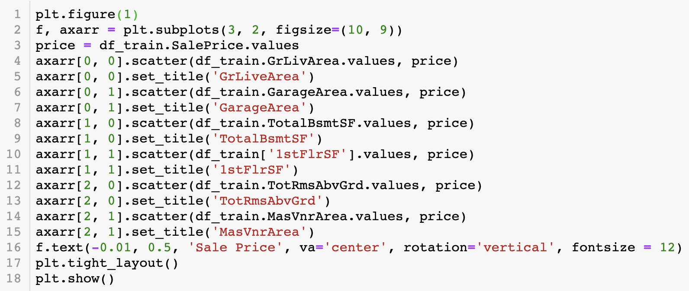
Numerical Data on Sale Price
.

Slide 20
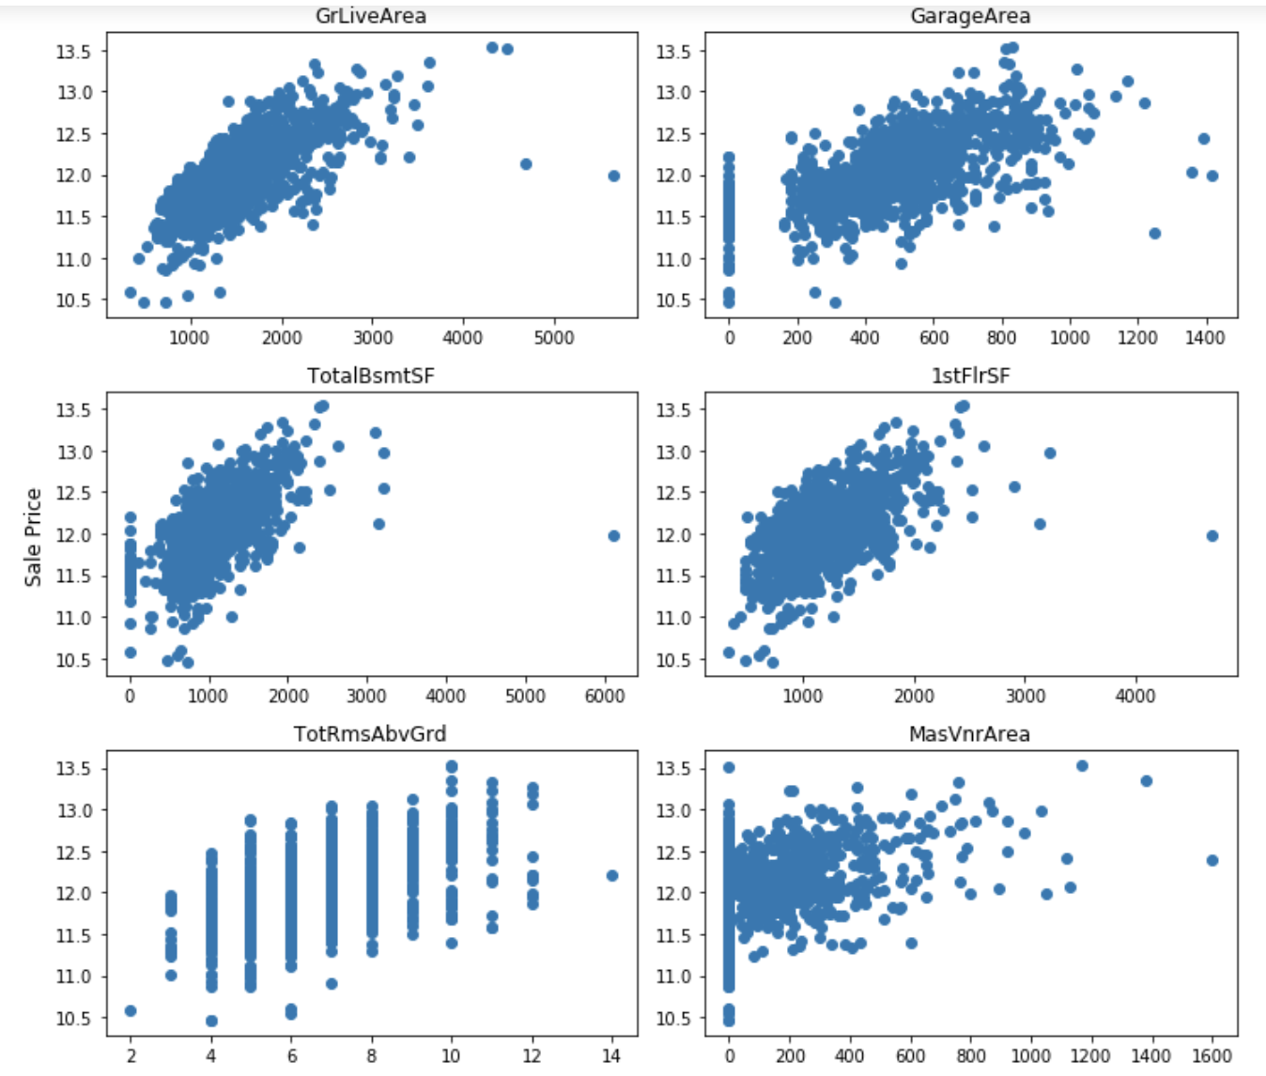
Numerical Data on Sale Price
.

Slide 21
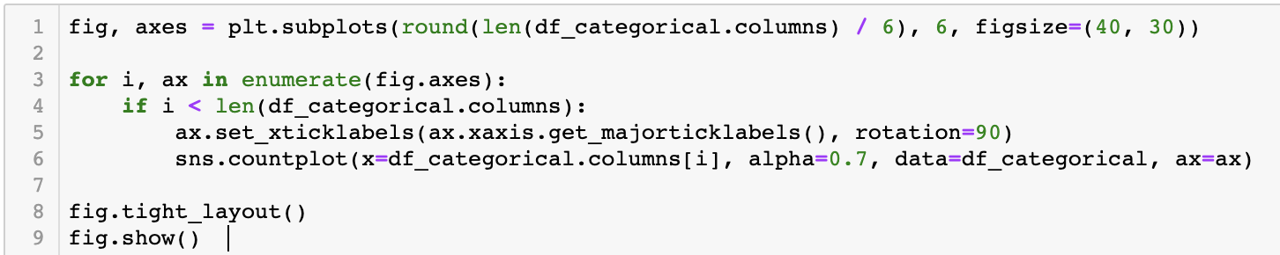
Categorical Data Exploration
.

Slide 22
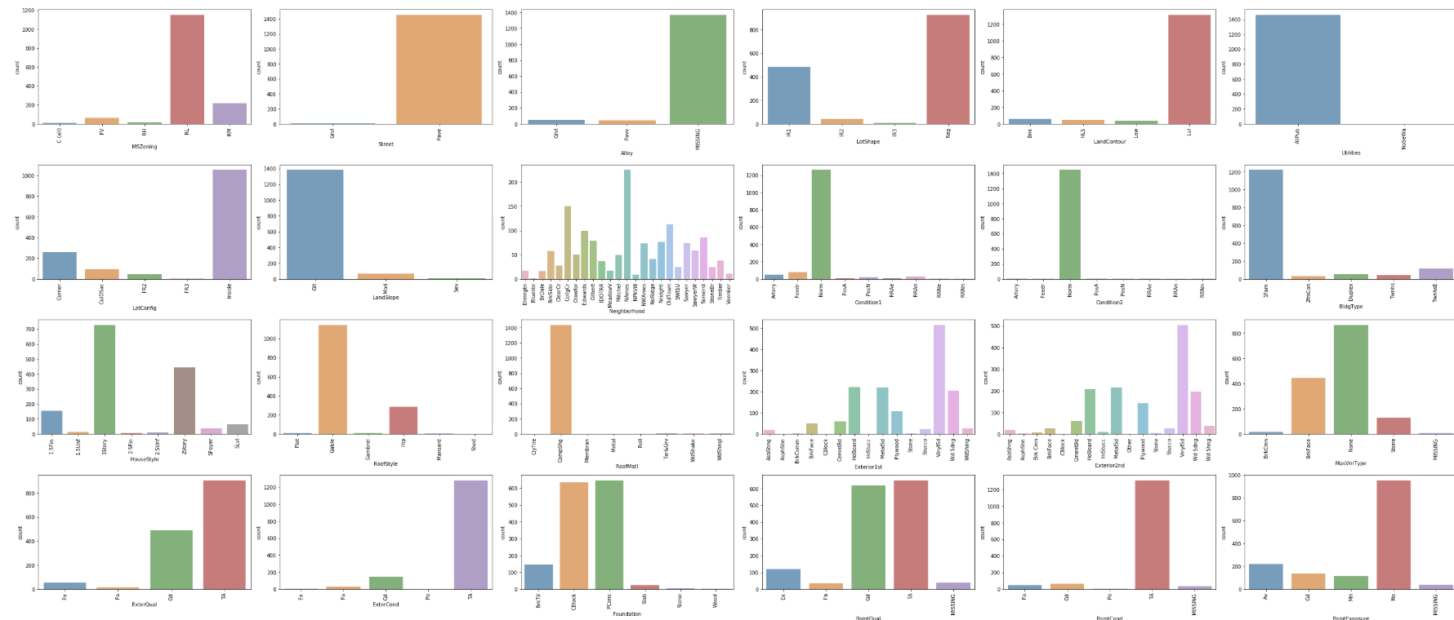
Categorical Data Exploration continue..
.

Slide 23
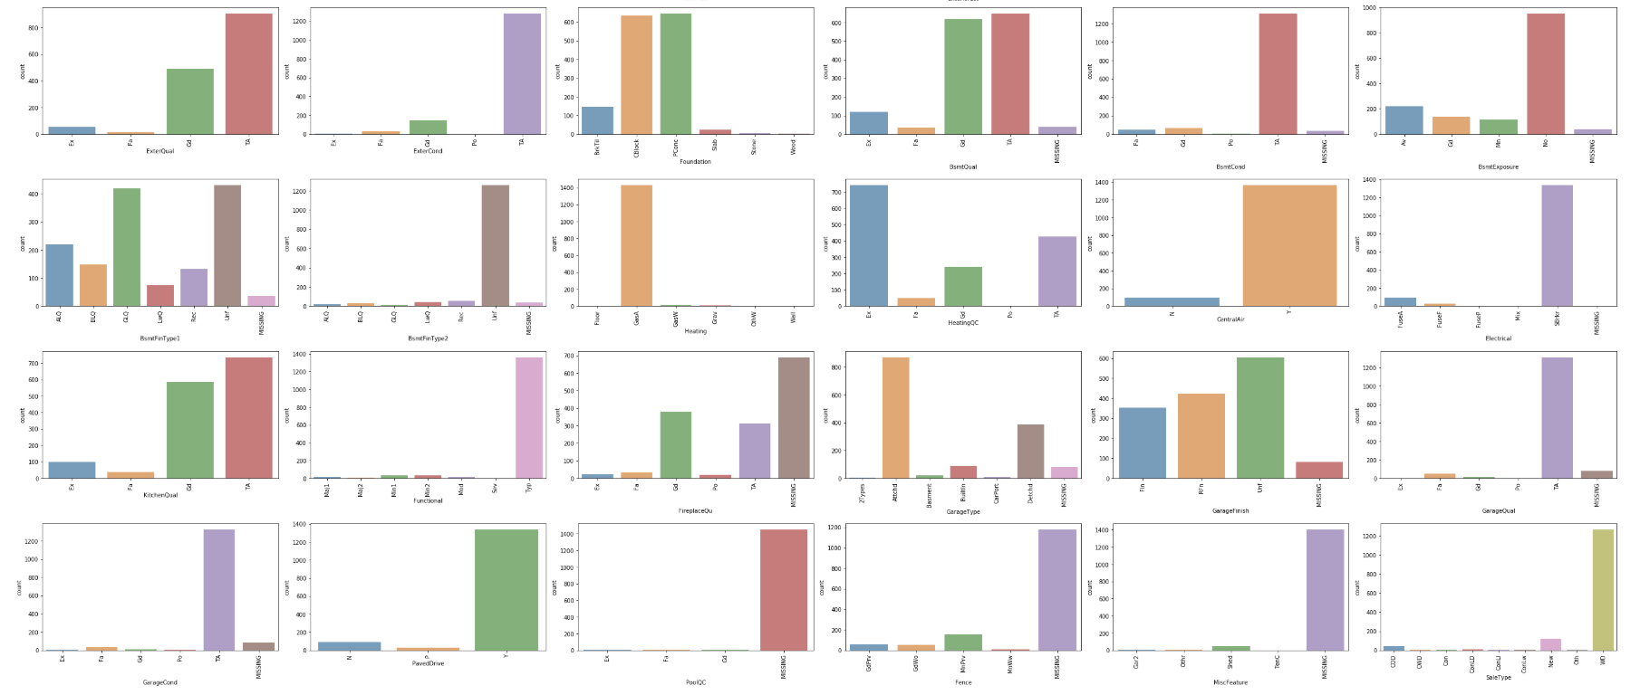
Categorical Data Exploration continue..
.

